Slide 1
Case Study
Christopher Apton

Slide 2
1.
Tasked: Week to date expectations at the sail_year, sail_month, and product_level
Assumptions:
No values for Saturday, assuming that Sunday has those values with it
pax_build resets each calendar week so we would need to calculate daily pax values

Slide 3
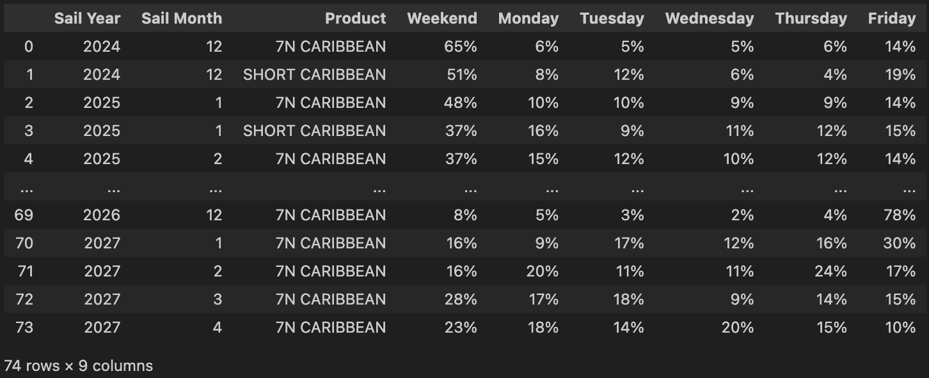
Results a)
Notes:
https://docs.google.com/spreadsheets/d/1k_29jiA7ItGW6r3FWDV5I7q-mjxFkDm0bYqzNocpxRY/edit?usp=sharing

Slide 4
b)
The approach was to average the daily percentage of total weekly bookings across all historical weeks for each product, month, year group. The primary abnormality was including cancellations with negative daily pax values created weeks with near-zero net totals, which caused extreme percentages and skewed the results. I tried to prevent the issue by ignoring the negative daily pax values as we are looking for WTD expectations. Also, using the median instead of mean for the average calculation so it’s less affected by extreme values. Lastly, the final results needed to be renormalized after taking the averages for each calendar week so it sums back up to 100%.

Slide 5
c)
Exploratory data analysis began with preparing the data and engineering a daily_pax feature to measure daily booking changes from the cumulative pax_build for each calendar week. After using this feature it was difficult to calculate WTD expectations when we included cancellations. So, in the final output, we removed cancellations and obtained gross bookings to generate cleaner results.

Slide 6
2.
Overestimating WTD expectations can cause a revenue manager to lower prices to meet a fake deficit which can reduce revenue. Also, underestimating WTD leads to missed opportunities to raise prices and capitalize on demand. It’s important to get accurate WTD targets for making correct pricing decisions that maximize revenue.

Slide 7
3.
Different products appeal to different booking behaviors, which explains the variance in your data. Longer, more expensive trips like the 7N CARIBBEAN are planned vacations often booked over the weekend, while shorter getaways are more spontaneous, showing strength later in the week. Extreme spikes, such as the 78% on a Friday for a far-future cruise, are not organic but are almost certainly driven by major, concentrated sales events like Black Friday.

Slide 8
Part 2
SELECT SL.MANAGER, COUNT(DISTINCT MP.META_PRODUCT_CODE) AS NumberOfMetaProducts, COUNT(SL.SAIL_DATE) AS NumberOfSailings
FROM SAILING_LIST AS SL
INNER JOIN
META_PRODUCTS AS MP ON SL.RDSS_PRODUCT_CODE = MP.RDSS_PRODUCT_CODE
WHERE SL.SAIL_DATE > CURRENT_DATE
GROUP BY SL.MANAGER ORDER BY SL.MANAGER;

Slide 9
2.
WITH PriceComparison AS (
SELECT SHIP, PRICE, LAG(PRICE, 1) OVER (PARTITION BY SHIP, SAIL_DATE ORDER BY RUN_DATE) AS Previous_Price
FROM PRICING_HISTORY
)
SELECT SHIP, COUNT(*) AS NumberOfPriceChanges
FROM PriceComparison
WHERE PRICE <> Previous_Price
GROUP BY SHIP
ORDER BY NumberOfPriceChanges
DESC LIMIT 1;

Slide 10
3.
WITH DailyPriceDeltas AS (
SELECT SHIP, SAIL_DATE, PRICE - LAG(PRICE, 1) OVER (PARTITION BY SHIP, SAIL_DATE ORDER BY RUN_DATE) AS PriceChange
FROM PRICING_HISTORY
WHERE RUN_DATE BETWEEN '2025-06-13' AND '2025-06-18'
)
SELECT SHIP, SAIL_DATE, AVG(PriceChange) AS AveragePriceChange
FROM DailyPriceDeltas
WHERE PriceChange <> 0
GROUP BY SHIP, SAIL_DATE
ORDER BY SHIP, SAIL_DATE;

Slide 11
4.
WITH PriceChangeDates AS (
SELECT SHIP, SAIL_DATE, RUN_DATE FROM (
SELECT SHIP, SAIL_DATE, RUN_DATE, PRICE, LAG(PRICE, 1) OVER (PARTITION BY SHIP, SAIL_DATE ORDER BY RUN_DATE) AS Previous_Price
FROM PRICING_HISTORY
) AS PriceComparison
WHERE PRICE <> Previous_Price
)
SELECT SL.MANAGER, MAX(PCD.RUN_DATE) AS LastPriceChangeDate
FROM SAILING_LIST AS SL
JOIN PriceChangeDates AS PCD
ON SL.SHIP = PCD.SHIP AND SL.SAIL_DATE = PCD.SAIL_DATE
GROUP BY SL.MANAGER
ORDER BY LastPriceChangeDate ASC
LIMIT 1;

